Slide 1
PRESENTED BY : Sanskruti duche

Slide 2
Simple calculator using python

Slide 3
Introduction
Python is a popular programming language. It was created by Guido van Rossum, and released in 1991.
It is used for :
Web development ( server- side ).
Software development .
Mathematics.
System scripting .

Slide 4
Python Programming Language is very well suited for begginers, also for experienced programmers with other programming languages like C++ and Java . The biggest strength of python is huge collection of standard libraries which can be used for the following GUI Applications ( like Kivy , Tkinter, PyQt etc )
Machine learning
Web frameworks like Django ( used by Youtube, Instagram, Dropbox )
Text processing and many more
Multimedia
Test frameworks

Slide 5
About the project
For those who do not know, a calculator is a basically a program on a computer that simulates the behavior of any hand-held calculator useful for performing Mathematical Calculations. It is a very basic device used in our everyday lives. Now all the smartphones also have a calculator in them.
While creating any GUI Application there are mainly two steps:
First step to create a User Interference .
Second step is the most important one in this, to add functionalities to the GUI.

Slide 6
Main Components •Tkinter: Python library used for building graphical user interfaces. •Key Components in Tkinter: •Root Window: The main container for the app (root = tk.Tk()). •Text Widget: Displays the current calculation and result (tk.Text). •Buttons: Used for input and triggering actions (tk.Button).

Slide 7
Code Explanation: Functionality 1. Global Variables: • calculation: Stores the ongoing arithmetic expression as a string. 2. Functions: • `add_to_calculation(symbol): • Appends user input (symbols) to the calculation. • Updates the display widget dynamically. • `evaluate_calculation(): • Evaluates the arithmetic expression using Python’s eval() function. • Handles errors like invalid input with exception handling. • `clear_field(): • Clears the calculation and resets the display.

Slide 8
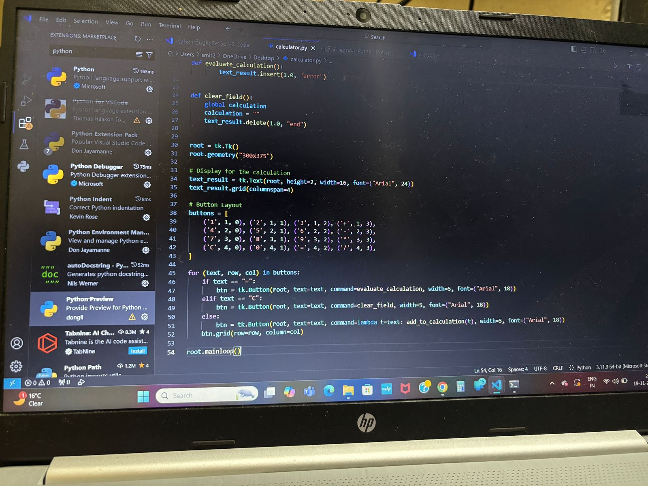
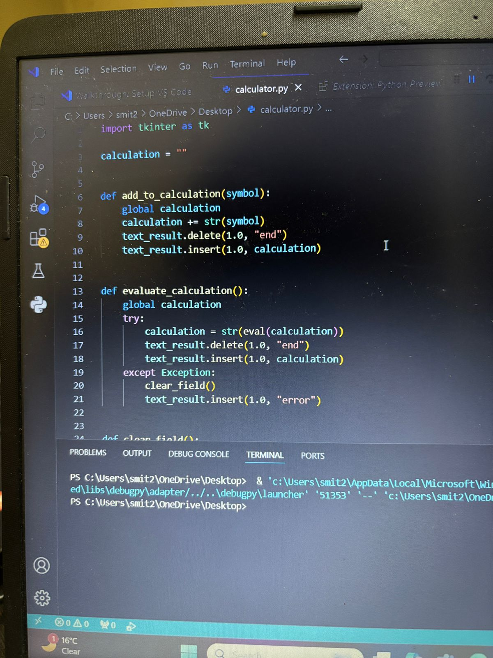
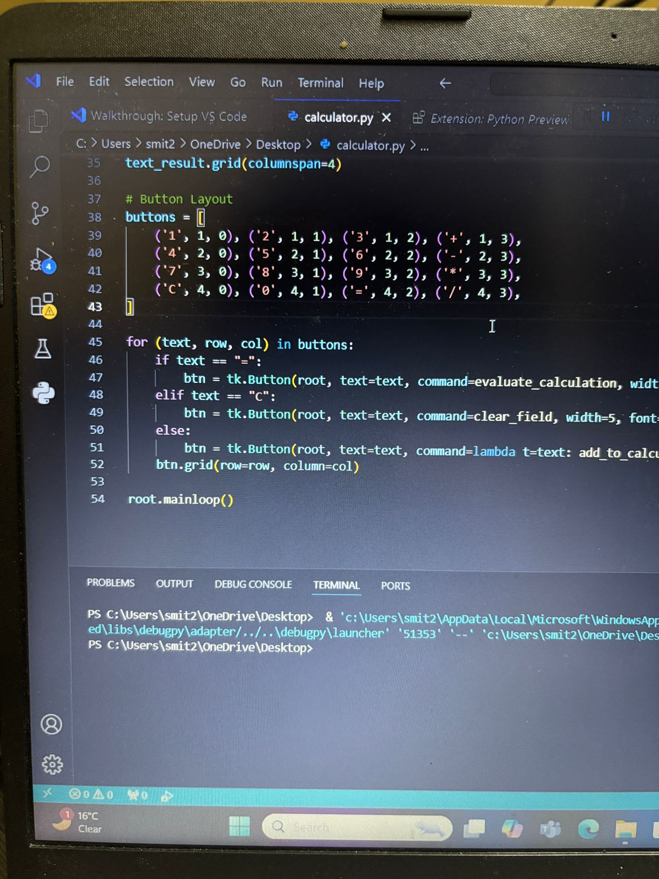

Slide 9
GUI Layout 1. Text Display: • Positioned at the top, displays the calculation and results. 2. Button Grid: • Buttons arranged in a 4x4 grid layout: • Rows 1–3: Digits (1–9) and operators (+, -, *, /). • Row 4: Clear (C), Zero (0), Equals (=), and Divide (/). 3. Button Configuration: • Command-based callbacks execute the respective functionality.

Slide 10
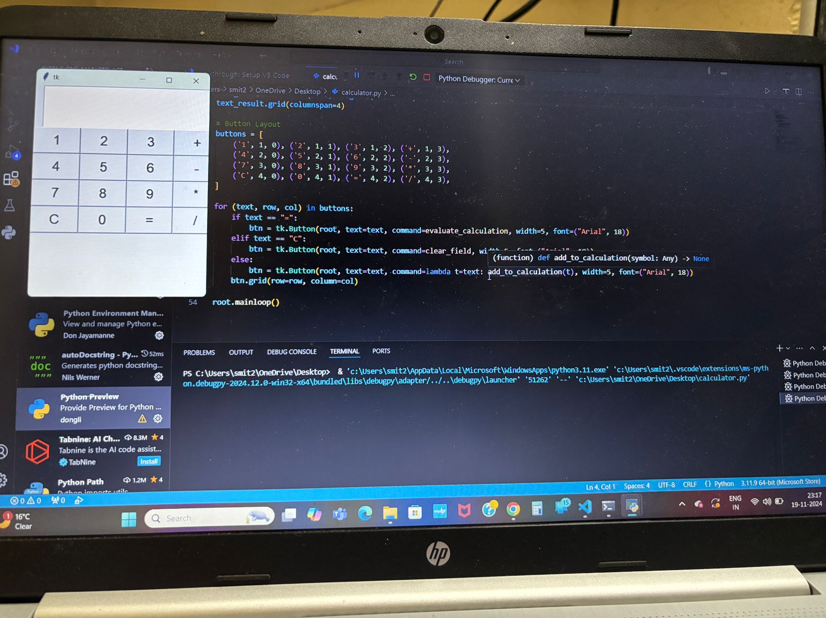
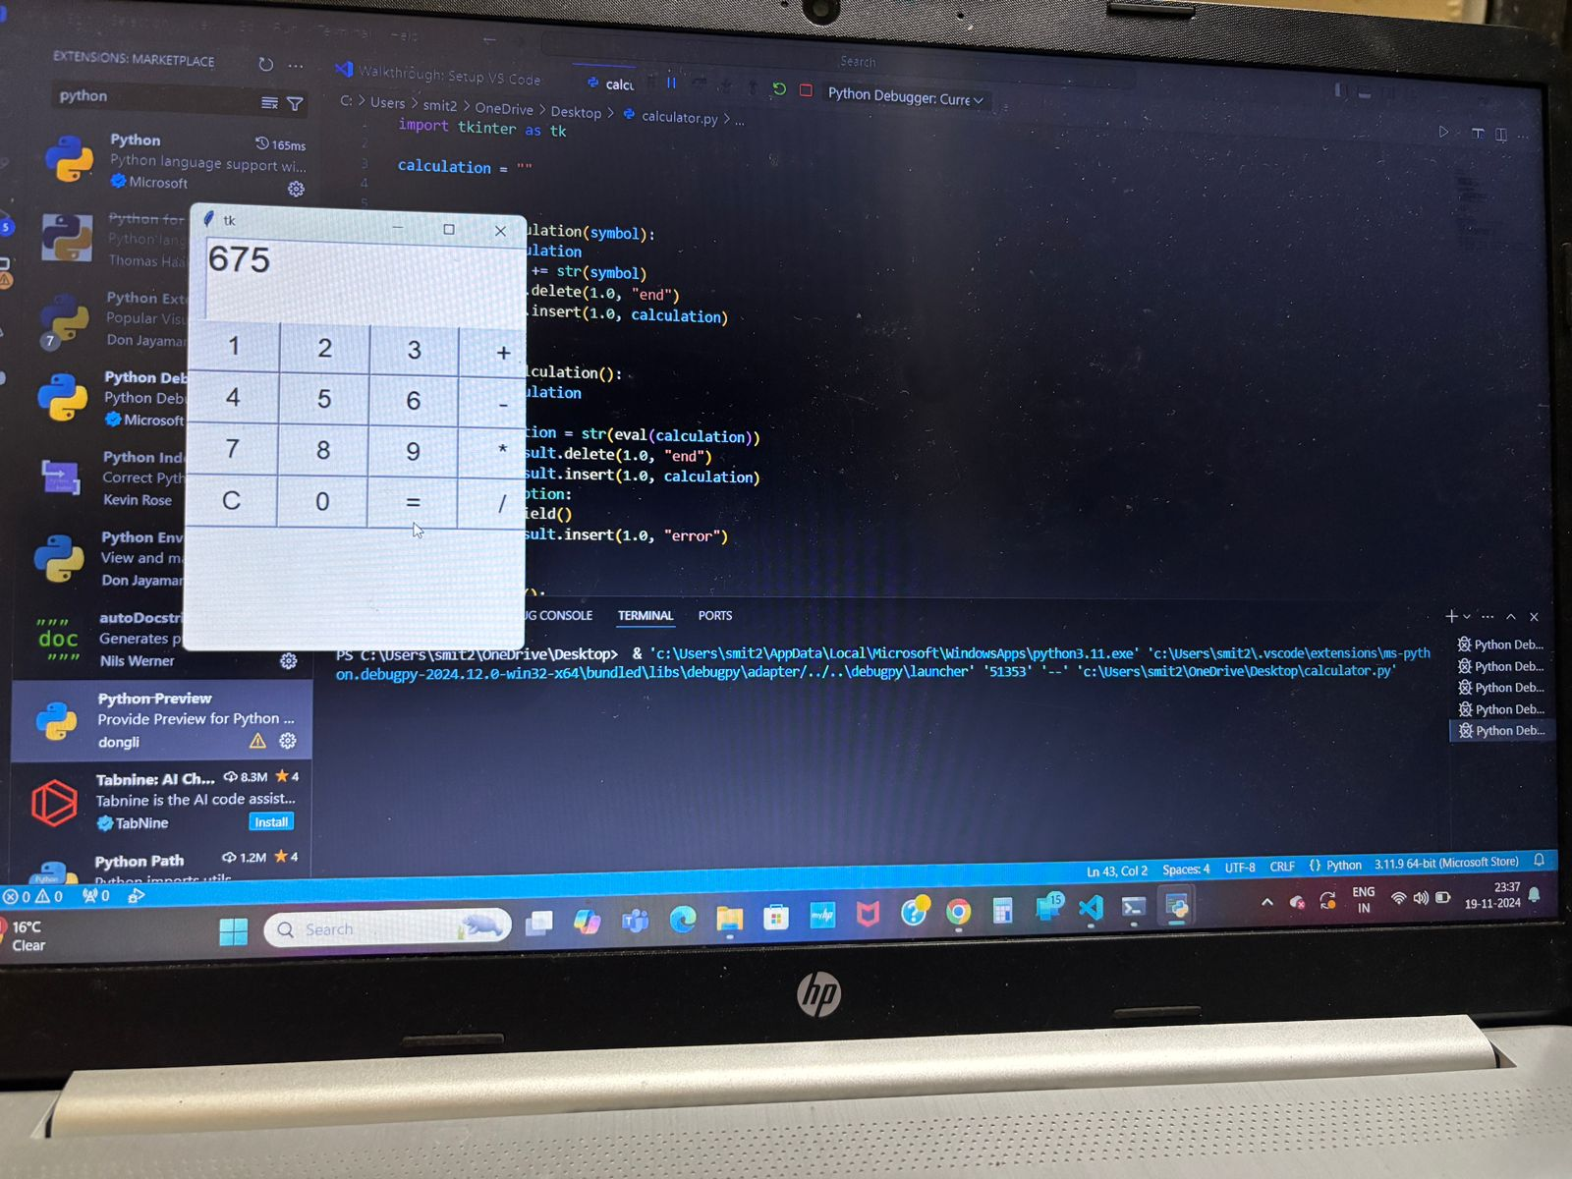
Demonstration
Live Demo:
Show how the calculator handles inputs, evaluates results, and resets on demand.

Slide 11
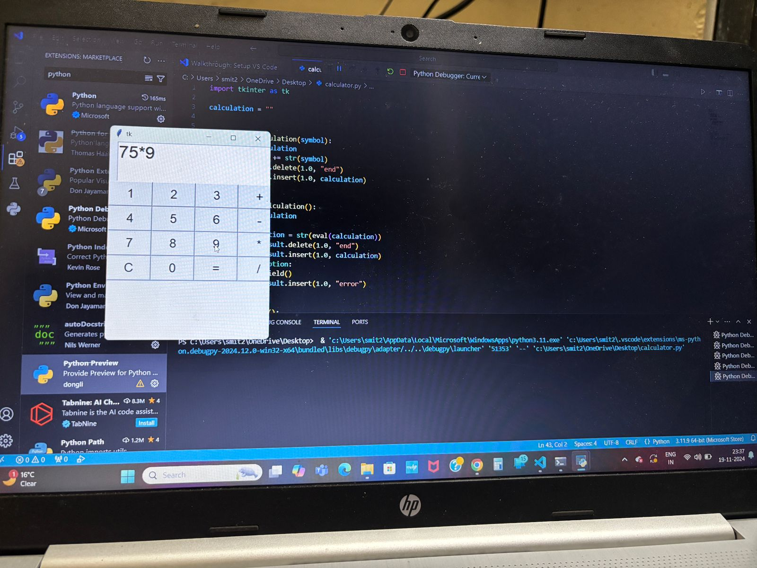
Features/Outputs: • Perform addition, subtraction, multiplication, and division. • Clear and reset functionality. • Dynamic display of results and calculations.

Slide 12
Conclusion
• Takeaway: A simple yet functional GUI calculator demonstrates the power of Python and Tkinter.
• Further Learning: Explore Tkinter to create more advanced and user-friendly applications.

Slide 13
Thank you

